Slide 1
Introduction to Statistics
By:
Dr. Basharat Mahmood

Slide 2
Overview of Statistics
Statistics is the science of collecting, organizing, presenting, analyzing, and interpreting data.
Importance of Statistics:
- Provides tools for making informed decisions based on data.

Slide 3
Usage of Statistics in Different Domains
Business and Economics:
Market analysis
Financial forecasting
Healthcare:
Clinical trials
Government:
Policy-making
Census data analysis

Slide 4
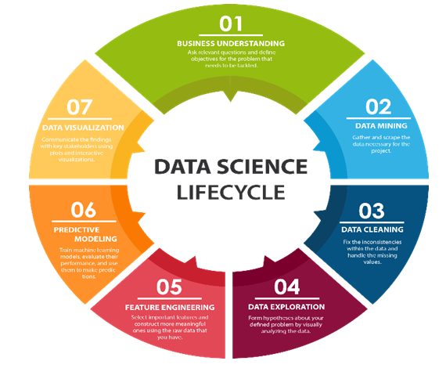
Significance of Statistics in Data Science
Statistics plays a crucial role in data science:
Data cleaning and preprocessing
Exploratory data analysis
Model selection and validation

Slide 5
Statistical Terminologies
Population vs. Sample
Population: The complete set of items or individuals that you are interested in studying.
Sample: A subset of the population that is selected to represent the whole population.
Parameter vs. Statistic
Parameter: numerical characteristic of a population
Statistic: numerical characteristic of a sample
Descriptive vs. Inferential Statistics
Descriptive Statistics: Methods used to summarize and describe the important characteristics of a data set.
Inferential Statistics: Methods used to make inferences or predictions about a population based on sample data.

Slide 6
Statistical Terminologies
Variables: characteristics or attributes
Numerical: measurable quantities and can be expressed as numbers. Discrete (children in a family), Continues (age, salary)
Categorical: represent categories or groups. Binary(true/false), Nominal (Ethnicity), Ordinal (level of Education)
Independent: variables that are manipulated or controlled in a study. They are inputs to a statistical model (income)
Dependent: variables that are measured or observed in a study (Expenditures)

Slide 7
Steps in the Statistical Process
Define the Problem: Formulate research questions/hypotheses
Design the Study: Select appropriate methods and data collection techniques
Collect Data: Methods of data collection
Analyze Data: Descriptive and inferential statistics
Interpret Results: Draw conclusions based on data analysis
Report Findings: Communicate results effectively

Slide 8
1. Problem Definition
Process of clearly defining the research problem or question
Establishes the scope and objectives of the study
Steps:
Identify the Research Area
Review Existing Literature
Define the Research Problem
Formulate Research Questions or Hypotheses
Justify the Importance of the Study

Slide 9
1. Problem Definition...
Example Project: Teaching ratings
Research Problem
Investigate factors influencing teaching ratings among university professors
Main Research Question
What factors contribute to variations in teaching ratings among university professors?

Slide 10
1. Problem Definition...
Subsidiary Research Questions
How does teaching experience influence student ratings of professors?
Is there a correlation between professor accessibility outside of class and teaching ratings?
Do student demographics (e.g., age, major) affect perceptions of teaching quality?
Are there differences in teaching ratings across different disciplines or departments?
How does the use of technology in teaching impact student evaluations?

Slide 11
2. Study Desing
The structure or plan that guides the collection and analysis of data
Determines how research questions are answered, and conclusions drawn
Types of Study Desing:
Cross-sectional Study: Collect data at a single point in time to analyze relationships
Longitudinal Study: Follows participants over an extended period to observe changes over time
Experimental Study: Manipulates variables to observe cause-and-effect relationships

Slide 12
2. Study Desing …
Sampling Strategy
Define the target population (e.g., university professors)
Select a representative sample to generalize findings to the population
Data Collection Methods
Survey
Interviews
Extraction of data from records
Variables:
Independent variables: Teaching experience, accessibility, use of technology.
Dependent variable: Teaching ratings by students.

Slide 13
3. Study Desing …
Data Analysis Plan:
Perform descriptive statistics to summarize data (mean, standard deviation)
Conduct correlation analysis to identify relationships between variables
Use regression analysis to assess the impact of independent variables on teaching ratings

Slide 14
3. Data Collection
Process of gathering information on variables
Ensures data quality and reliability for analysis
For this project, we will use the following dataset collected in University of Texas
teachingratings.csv

Slide 15
4. Data Analysis
Measures of Central Tendency
Measures of Dispersion
Shape of the Distribution

Slide 16
Measures of Central Tendency
Center measurement is a summary measure of the overall level of a dataset
Commonly used methods are mean, median, mode etc.
Mean: Summing up all the observation and dividing by number of observations. Mean of 20, 30, 40 is (20+30+40)/3 = 30.

Slide 17
Methods of Center Measurement
Median: The middle value in an ordered sequence of observations. That is, to find the median we need to order the data set and then find the middle value. In case of an even number of observations the average of the two middle most values is the median. For example, to find the median of {9, 3, 6, 7, 5}, we first sort the data giving {3, 5, 6, 7, 9}, then choose the middle value 6. If the number of observations is even, e.g., {9, 3, 6, 7, 5, 2}, then the median is the average of the two middle values from the sorted sequence, in this case, (5 + 6) / 2 = 5.5.
Mode: The value that is observed most frequently. The mode is undefined for sequences in which no observation is repeated.

Slide 18
Mean or Median
The median is less sensitive to outliers (extreme scores) than the mean and thus a better measure than the mean for highly skewed distributions, e.g. family income. For example mean of 20, 30, 40, and 990 is (20+30+40+990)/4 =270. The median of these four observations is (30+40)/2 =35. Here 3 observations out of 4 lie between 20-40. So, the mean 270 really fails to give a realistic picture of the major part of the data. It is influenced by extreme value 990.

Slide 19
Measures of Central Tendency
Variability (or dispersion) measures the amount of scatter in a dataset.
Commonly used methods: range, variance, standard deviation, interquartile range, coefficient of variation etc.
Range: The difference between the largest and the smallest observations. The range of 10, 5, 2, 100 is (100-2)=98. It’s a crude measure of variability.

Slide 20
Methods of Variability Measurement
Variance: The variance of a set of observations is the average of the squares of the deviations of the observations from their mean. In symbols, the variance of the n observations x₁, x₂,…x_{n} is
Variance of 5, 7, 3? Mean is (5+7+3)/3 = 5 and the variance is
Standard Deviation: Square root of the variance. The standard deviation of the above example is 2.

Slide 21
Methods of Variability Measurement
Quartiles: Data can be divided into four regions that cover the total range of observed values. Cut points for these regions are known as quartiles.
In notations, quartiles of a data is the ((n+1)/4)q^{th} observation of the data, where q is the desired quartile and n is the number of observations of data.
The first quartile (Q1) is the first 25% of the data. The second quartile (Q2) is between the 25th and 50th percentage points in the data. The upper bound of Q2 is the median. The third quartile (Q3) is the 25% of the data lying between the median and the 75% cut point in the data.
Q1 is the median of the first half of the ordered observations and Q3 is the median of the second half of the ordered observations.

Slide 22
Methods of Variability Measurement
In the following example Q1= ((15+1)/4)1 =4th observation of the data. The 4th observation is 11. So Q1 is of this data is 11.
An example with 15 numbers
3 6 7 11 13 22 30 40 44 50 52 61 68 80 94 Q1 Q2 Q3
The first quartile is Q1=11. The second quartile is Q2=40 (This is also the Median.) The third quartile is Q3=61.
Inter-quartile Range: Difference between Q3 and Q1. Inter-quartile range of the previous example is 61- 40=21. The middle half of the ordered data lie between 40 and 61.

Slide 23
Deciles and Percentiles
Deciles: If data is ordered and divided into 10 parts, then cut points are called Deciles
Percentiles: If data is ordered and divided into 100 parts, then cut points are called Percentiles. 25th percentile is the Q1, 50th percentile is the Median (Q2) and the 75th percentile of the data is Q3.
In notations, percentiles of a data is the ((n+1)/100)p th observation of the data, where p is the desired percentile and n is the number of observations of data.
Coefficient of Variation: The standard deviation of data divided by it’s mean. It is usually expressed in percent.
= Coefficient of Variation =

Slide 24
Five Number Summary
Five Number Summary: The five number summary of a distribution consists of the smallest (Minimum) observation, the first quartile (Q1),
The median(Q2), the third quartile, and the largest (Maximum) observation written in order from smallest to largest.

Slide 25
Skewness
Skewness is a measure of the asymmetry of a probability distribution or a set of data points around its mean.
It indicates whether the distribution is symmetric or skewed to one side.
A symmetric distribution has a skewness of zero, while a distribution that is skewed to the right (positively skewed) has a positive skewness value, and a distribution skewed to the left (negatively skewed) has a negative skewness value.

Slide 26
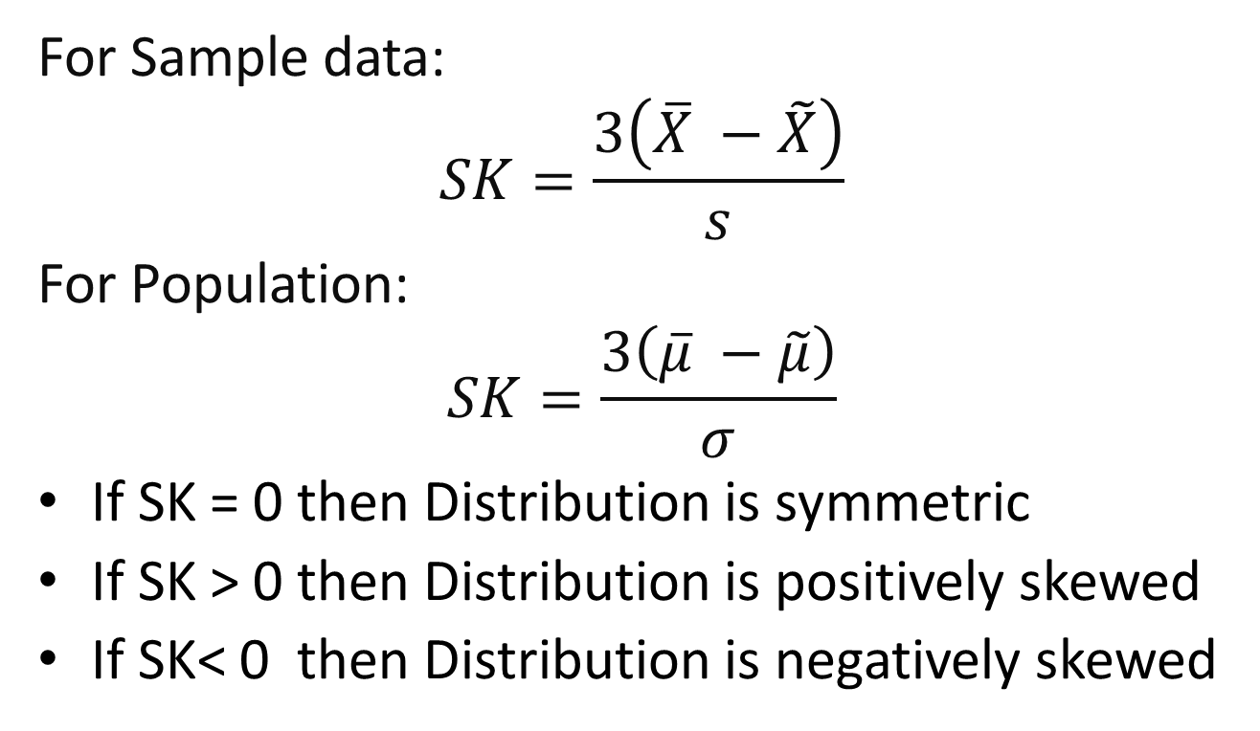
Skewness…
For Sample data:
$$SK=\frac{3\left(\overline{X} −\tilde{X}\right)}{s}$$
For Population:
$$SK=\frac{3\left(\overline{μ} −\tilde{μ}\right)}{σ}$$
If SK = 0 then Distribution is symmetric
If SK > 0 then Distribution is positively skewed
If SK< 0 then Distribution is negatively skewed

Slide 27
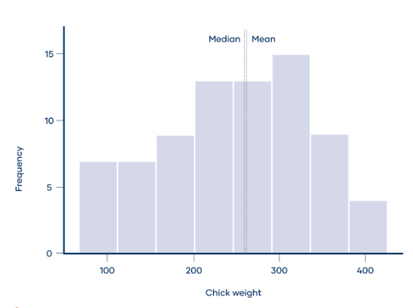
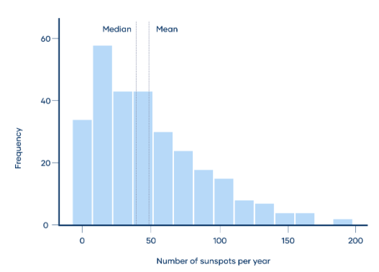
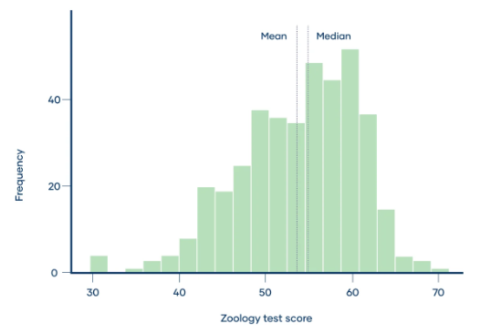
Skewness…

Slide 28
Skewness…
Empirical Rule:
68% of the observations lie within 1 standard deviation of the mean
95% of the observation lie within 2 standard deviations of the mean
99.7% of the observations lie within 3 standard deviations of the mean

Slide 29
Kurtosis
Kurtosis is a statistical measure that describes the shape of a probability distribution's tails in relation to its peak (or central tendency).
Mesokurtic- If the kurtosis value is zero, it indicates that the distribution has the same kurtosis as the normal distribution.
Leptokurtic- If the kurtosis value is positive, it indicates that the distribution has fatter tails and a sharper peak than the normal distribution. This implies that there are more extreme values in the dataset than would be expected under a normal distribution.

Slide 30
Kurtosis…
…
Platykurtic- If the kurtosis value is negative (less than 3), it indicates that the distribution has thinner tails and a flatter peak than the normal distribution. This implies that extreme values are less likely to occur than in a normal distribution.

Slide 31
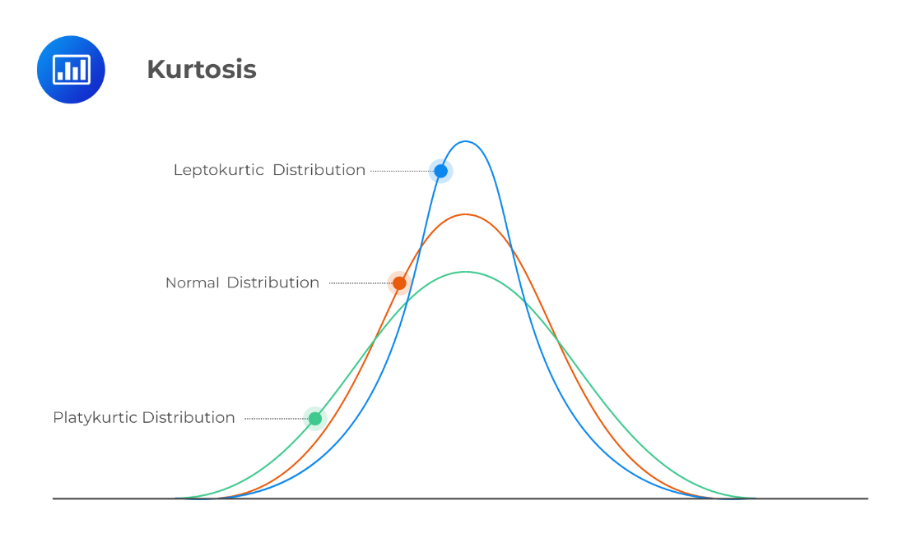
Kurtosis…
…
Platykurtic- If the kurtosis value is negative (less than 3), it indicates that the distribution has thinner tails and a flatter peak than the normal distribution. This implies that extreme values are less likely to occur than in a normal distribution.

Slide 32

Kurtosis ….
Kurtosis = 3 (Mesokurtic, expected outliers are like normal distribution)
Kurtosis > 3 (Leptokurtic, more expected outliers than normal)
Kurtosis < 3 (Platykurtic, less outliers are expected than normal distribution)

Slide 33
Moments
In statistics, moments are mathematical quantities that provide information about the shape, central tendency, and variability of a probability distribution or a set of data.
Moments are used to summarize the characteristics of a distribution and are calculated based on the values and frequencies of the data points.

Slide 34
Moments …
Zeroth Moment (Mean): The zeroth moment, also known as the mean, is the average value of a set of data points.
First Moment (Variance): The first moment, also known as the variance, measures the dispersion or spread of the data points around the mean.
Second Moment (Skewness): The second moment, also known as skewness, measures the asymmetry of the distribution.
Third Moment (Kurtosis):
The third moment, also known as kurtosis, measures the peakedness or flatness of the distribution.

